Slide 1
Virtual Travel Agent
Team: James G, William C, Key J

Slide 2
Tech Stack
HTML/CSS
PHP
Javascript
MySQL
WAMP
GitHub (Version Control)
GroupMe (Team Co-ordination)

Slide 3
Task
Travel booking to anywhere to visit a destination
Book flights (choose their seating should show the availability)
Select rental car (Type- SUV, Compact, Midsize, and Luxury)
Pre-pay for the parking - This system should show the availability of parking along with a variation of prices based up when time frame of purchase, space accommodation and along with a VIP section. **Bonus (Display trending now parking section)

Slide 4
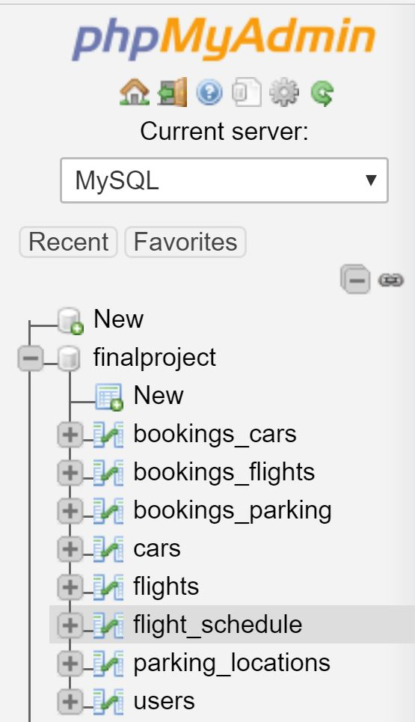
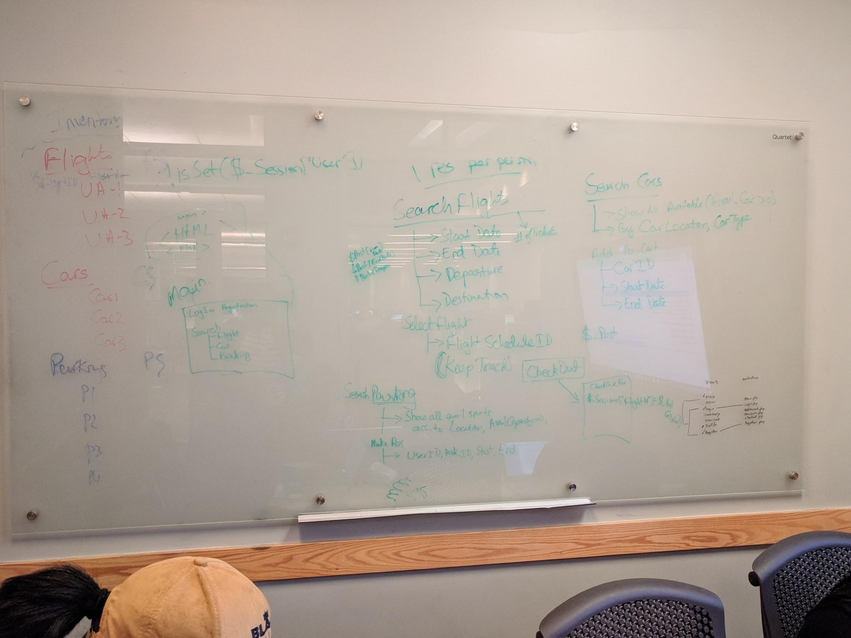
Some Challenges
Designing the system to keep track of Dates, Times Capacity Limits.
Simpler to implement without keeping track of date, time and capacity limits.

Slide 5
Use Cases
Log In
Log out
Sign up/Register
Search (flights, car rentals, Parking)
Add to cart
Remove from cart
Buy/purchase
Profile Page + Purchase History

Slide 6
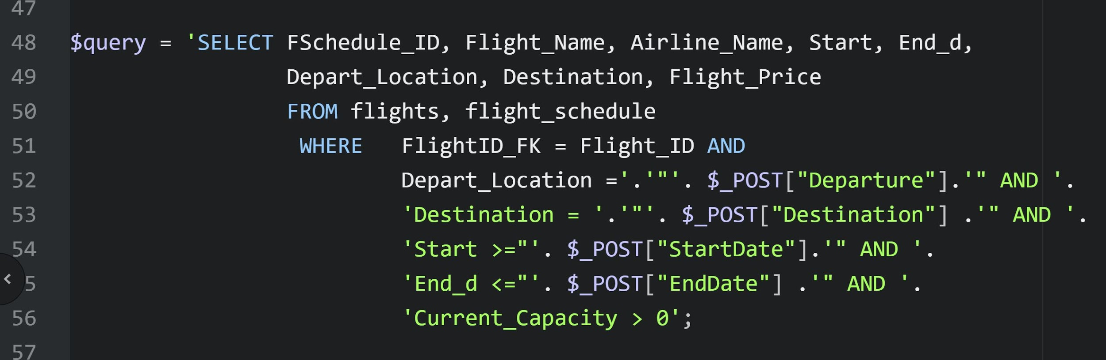
Sample Queries and Code

Slide 7
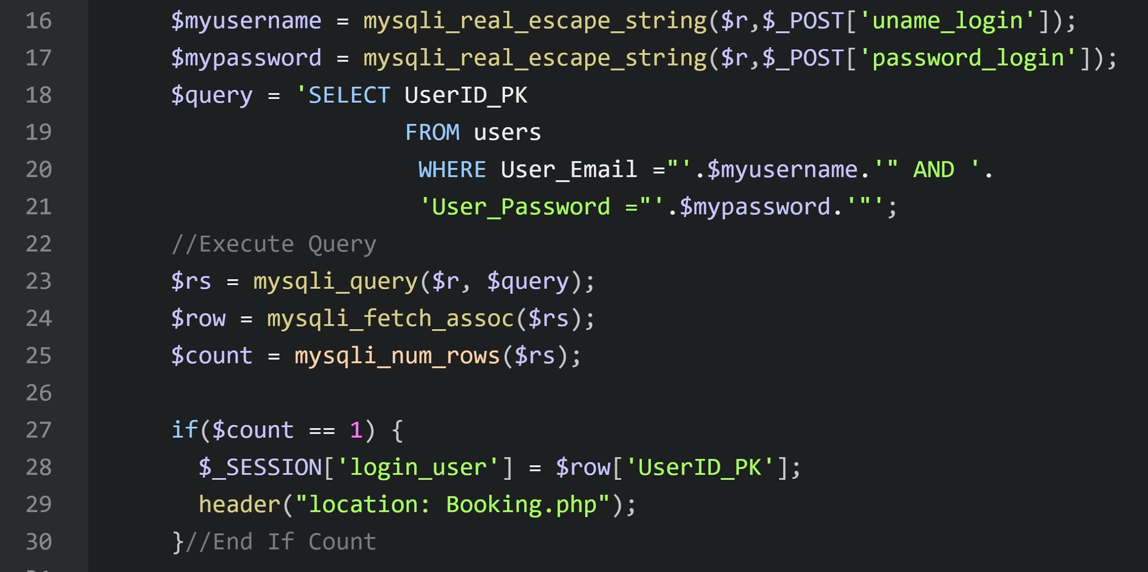
Sample Queries and Code

Slide 8
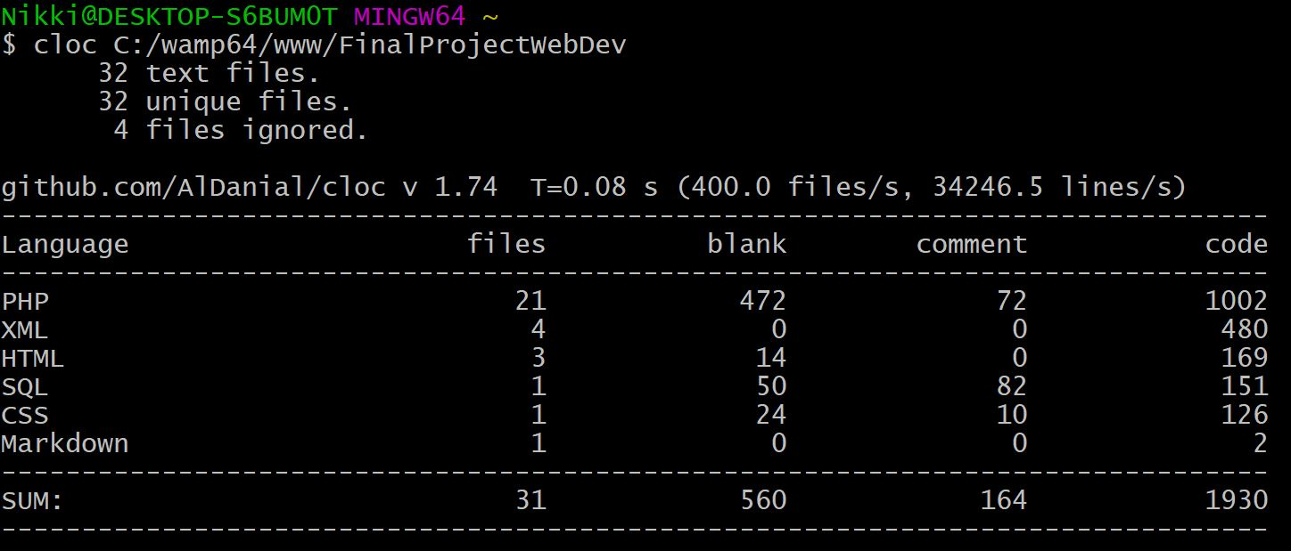
Summary

Slide 9
Demo & Questions

